Slide 1
Digital Portfolio
STUDENT NAME:SABARI.B
REGISTER NO :20324U48027
NMID: A0411CAAF0FA458A1BF488E4B6F16DC3
DEPARTMENT: BSC.DATA SCIENCE
COLLEGE: Dr. M.G.R. CHOCKALINGAM ARTS COLLEGE,ARNI
UNIVERSITY:THIRUVALLUVAR UNIVERSITY

Slide 2
PROJECT TITLE
STUDENT DIGITAL PORTFOLIO USING FRONT END WEB DEVELOPMENT (HTML, CSS & JAVA SCRIPT)

Slide 3


AGENDA
Problem Statement
Project Overview
End Users
Tools and Technologies
Portfolio design and Layout
Features and Functionality
Results and Screenshots
Conclusion
Github Link
3/21/2024 Annual Review

Slide 4

PROBLEM STATEMENT
In today's digital age, students often struggle to effectively showcase their academic achievements, skills, projects, and extracurricular activities in a centralized, accessible, and visually appealing format. Traditional methods such as printed resumes or scattered online documents fail to present a cohesive and dynamic representation of a student's abilities and growth over time.

Slide 5

PROJECT OVERVIEW
In the digital era, a personal portfolio is an essential tool for students to demonstrate their capabilities beyond a traditional resume. This project will create a responsive and interactive web application using HTML, CSS, and JavaScript (optionally including frameworks like React or Bootstrap) to help students:
Create a personal online identity.
Display educational qualifications and certificates.
Showcase academic and personal projects.
Highlight technical and soft skills.
Provide downloadable resumes and external links (e.g., LinkedIn,GitHub).

Slide 6

WHO ARE THE END USERS?
End User | Role | Purpose
Students | Creators and owners | Build and maintain their own portfolio
Teachers/Mentors | Reviewers and guides | Evaluate and support student progress
Employers/Recruiters | Potential hirers | Discover and assess talent
Admissions Officers | Evaluators for academic programs | Review detailed student profiles
General Public/Peers | Visitors or collaborators | Explore, learn, and connect

Slide 7

TOOLS AND TECHNIQUES
Dark/Light Mode Toggle – Using JavaScript and CSS variables.
Animations & Transitions – Using CSS or libraries like AOS (Animate on Scroll).
Form Handling – Using JavaScript or integrating with services like Forms pree for contact forms.
Progressive Web App (PWA) – Making the portfolio installable and offline-accessible (advanced).

Slide 8
POTFOLIO DESIGN AND LAYOUT
Sections included:
Home/About Me
Projects
Skills
Contact
Responsive Layout (mobile + desktop view)
8

Slide 9
FEATURES AND FUNCTIONALITY
Navigation bar with smooth scrolling
Project showcase with images/details
Interactive elements(hover effects, animations)
Contact form(with validation)
Responsive design for all devices.

Slide 10
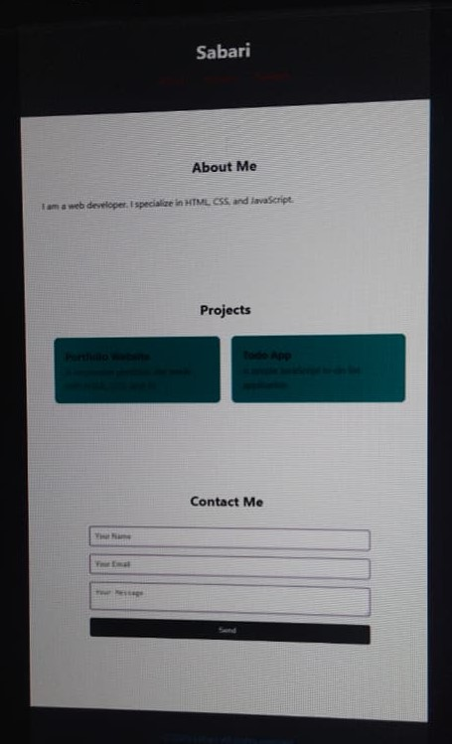

RESULTS AND SCREENSHOTS
Screenshots of each section
Before Vs After (plain HTML with CSS & JS
3/21/2024 Annual Review
10

Slide 11
CONCLUSION
The Employee Salary Prediction System successfully demonstrates the end-to-end application of machine learning in solving a real-world HR analytics challenge. By simulating realistic salary data and applying advanced modeling techniques, the system achieved high prediction accuracy and practical insights into salary dynamics.
" The use of SHAP for model explain ability added transparency, enabling users to understand key salary drivers. The Stream lit-based deployment ensured accessibility through a user friendly web interface.
This project highlights the effectiveness of combining data science, domain knowledge, and cloud deployment to deliver a scalable, production-ready solution for compensation intelligence.
11

